Slide 1
Facial Emotion Detection using CNN
Imarticus Learning
DL Project
Name – Ranjan Khamari
Batch-PGAA UCLA Batch -3

Slide 2
Contents
Imarticus Learning
Introduction
Problem Statement
Objective
Dataset Overview
Workflow/Methodology
Conclusion
Business Aspects

Slide 3
Why emotion detection?
Imarticus Learning
The motivation behind choosing this topic specifically lies in the huge investment done by large corporations do in the feedback and surveys mechanism but fail to get equitable responses.
Emotion detection through facial gesture is a technology that helps to improve product and services performance by monitoring customer behaviour to certain product and services staff by their evaluation.

Slide 4
Introduction
Imarticus Learning
Different emotion types are detected through the integration of information from facial expressions, body movement and gestures, and speech. The technology is said to contribute in the emergence of the so-called emotional or emotive Internet.
Emotion-sensing technologies can help employees make better decisions, improve their focus and performance in the workplace, manage stress, and also help them adopt healthier and more productive working styles.
In this project we are going to detect emotion using convolutional neural network because it is known for its image classification and high accuracy .The emotion we are going to detect are angry, disgust, sad, fear, surprise and happy.

Slide 5






Problem Statement
Imarticus Learning
Convolutional neural networks (CNN) have developed in this work for recognition of facial emotion expression. Facial expressions play a vital role in nonverbal communication which appears due to internal feelings of a person that reflects on the faces.
Happy
Sad
Angry
Disgust
Surprise
Fear

Slide 6
Objective
Imarticus Learning
Objective of this model is to come up with a strong convolutional neural network which will predict the facial expression of the human from the image.

Slide 7
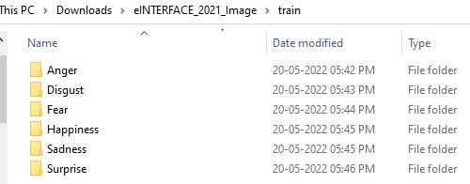
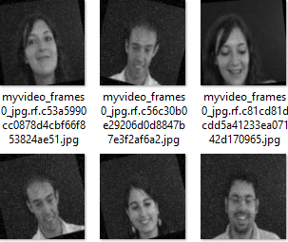
Datasets Sample
Imarticus Learning
This is a dataset that has been extracted from the famous eINTERFACE competition that was held in 2005. All video recordings were first converted to RGB Image and then re converted to 416x416 Grayscale images. The link to the original dataset : -http://www.enterface.net/results/

Slide 8

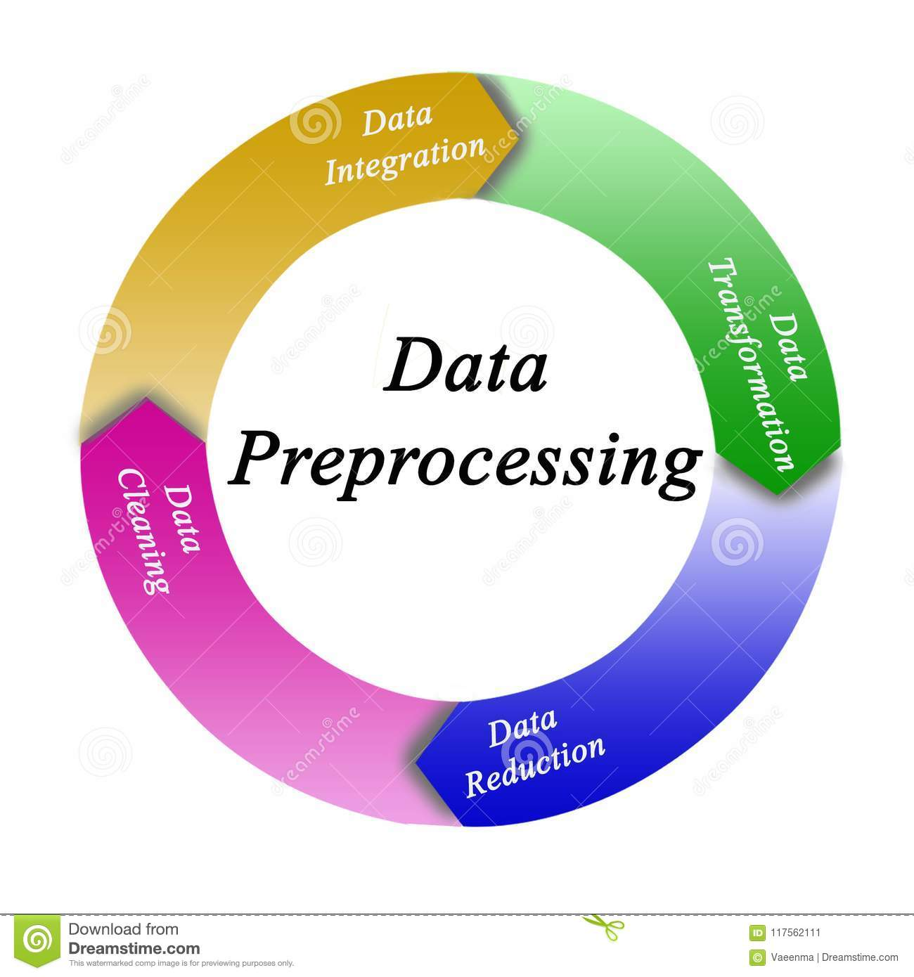
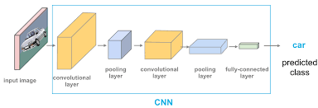

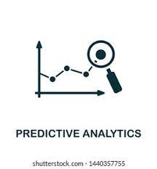
WORKFLOW
Imarticus Learning
Data
Image pre-processing
Convolutional Neural Network
Evaluation
Predictions

Slide 9
Methodology
Imarticus Learning
Importing the required libraries and then loading the data set obtained from github in jupyter notebook.
The datasets consists of three folder train ,validation, test within these folder again they are categorized into six categories that are Happy , Sad ,Fear ,Disgust ,Angry ,Surprise which is of 416*416 greyscale images.
More data generated is created using the training set by applying transformation .It is required If the training data set is not enough to learn representation .The image generated by transforming the actual training images by rotation ,shifts ,zoom ,flip , reflection ,normalization etc
These face object are reshaped and resize into 128 *218 greyscale images.

Slide 10
Imarticus Learning
The architecture of CNN Model consist of
1)Convolutional 2D
2)Activation function
3)Max pooling
4)Flattened
5)Optimiser =“Adam”
6)Loss function=“categorical cross-entropy”
7)Metrics=“Accuracy”

Slide 11
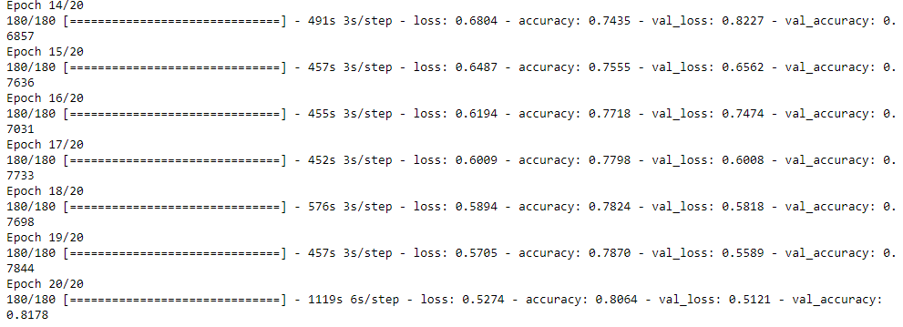
Performance Validation
Imarticus Learning
The model gives training accuracy of 81% and validation accuracy of 82%.So,the CNN learns the representation feature of emotion from the training images. Below are the few epochs of training process with batch size of 64.

Slide 12
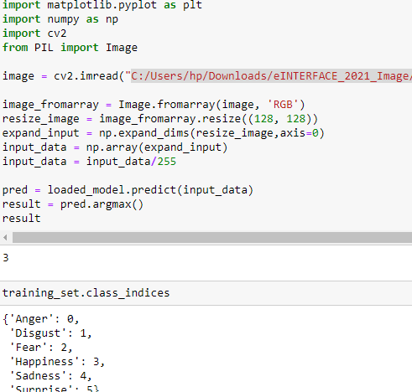
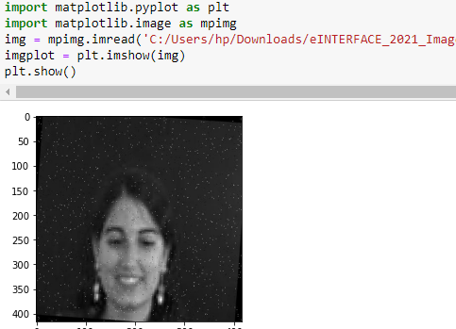
Predictions

Slide 13
Business Aspects
Imarticus Learning
Emotion detection system can be very helpful in taking review(e.g-movie , product) on the basis of emotion .It will be very helpful for product based or service based industry.
It can be used in detecting emotion from real time webcam.
Emotion recognition can be used to understand how candidates feel during interviews and to measure how they react to certain questions. This information can be used to optimize interview structure for future candidates and streamline the application process.

Slide 14

THANK Y☺U!!!
Imarticus Learning
YOUR QUESTIONS AND VALUABLE SUGGESTIONS ARE WELCOME
14

